Slide 1
Asterby & Chalkcroft Nursery
Proposed Redevelopment of Nursery Site and Funding of Village hall Car Park

Slide 2
Why redevelop site?
  The nursery has made a loss for two years running and cannot continue: it has struggled since the credit crunch. HTA analysis of the horticultural market suggests the future will not be bright.

Slide 3
Why redevelop site?
Long Term Prospect
Availability of plants from many retail outlets such as supermarkets, where convenience trumps plant quality and range. There is no need for a visit to a retail nursery for plants, especially involving an extra journey.
Long term market changes to number of owner occupiers. Increasingly the younger generation are renting their accommodation and will not ‘invest’ in the garden. Similarly, landlords will not plant beyond the bare minimum.
Rise in population has been driven to some extent by an increase in immigration, where a culture of gardening is not established. Other hobbies/pastimes are more preferable.
New build gardens are small thus reducing the number of plants required.
Many specialist nurseries have already disappeared. This is made evident in a study of the listed nurseries in the RHS Plant finder from when we started 15 years ago (over 50 entries) and this year (25 entries). The current edition shows either garden centres or nurseries specialising in a few species.
The market in gardening plants is reducing and the existing players are expanding by reducing price to increase market share. Waitrose has announced plans to increase market share to 10% and has hired Alan Titchmarsh to head their campaign. A reduction in price affects our profit margins as the selling prices have not increased since 2010 although staff wages, utilities, insurance, etc. continue to increase. With the rise in internet shopping, price competition will intensify.
Strong Sterling against the Euro currency. Plant growing takes time and once the plants are ready for sale, we cannot sensibly reduce the price because imports from Europe are cheaper.
Notes:
Information based on HTA Garden Retail market Analysis 2014 and DEFRA Glasshouse Survey 2012

Slide 4
Long Term Prospect (contd)
We have been here for nearly 15 years. Justin was only 3 months old when we arrived.
In that time we have seen other retail garden centres/nurseries come and go such as Gardeners’ Village outside Upper Caldedote (now a veterinary surgery), New Road in Gt Barford (now a plant hire centre and Gospel hall) and several changes of leaseholders at Home and Garden Discount Centre in Willington. Greensand Nursery has also closed. Mary Langley Nursery off the A1 now concentrates on rocks and decorative stones with a small selection of plants.
We are no longer viable.

Slide 5
Alternative Uses
Garden centre?
Planning permission for a Garden Centre was refused as current policy is to reduce the amount of retailing in the countryside. So a supermarket can sell our products but we cannot sell any other category of products.
In discussion with the local planning authority, the only permitted diversification would be agriculture and that is not profitable.

Slide 6
Local Planning Policy
 | Under current planning policy Local Development Framework DM12 ( approved 2009) Support for Commercial development
 | Proposals for commercial development on horticultural or redundant
 | agricultural sites in the countryside will be approved if they are
 | considered acceptable when considered in terms of their:
 | · Scale, layout and design in relation to their setting;
 | · Assimilation into the rural setting and impact on the surrounding
 | countryside when assessed against the findings of the Landscape
 | Character Assessment;
 | · Relationship with the road network and neighbouring rural
 | settlements;
 | · Potential impact on existing local retail facilities;
 | · Provision of suitable vehicular and pedestrian access arrangements;
 | Proposals for redevelopment will require evidence that an agricultural,
 | market gardening or horticultural nursery use is not viable.
 | Proposals will be approved if they are considered acceptable against the above criteria

Slide 7
The policy demonstrates that a commercial development would be acceptable so why not a residential one? Residential buildings are smaller in scale than commercial buildings and more easily assimilated in the surroundings.

Slide 8
Village Hall Car Park
Cost of building the car park for about 40 cars is likely to exceed £50,000
Annual excess income from Village hall is about £2,000 --assuming no major maintenance items.
No grants are available for building car parks
Average Community Infrastructure Levy raised per house about £500 for local facilities of which the village hall is part. Do you wish to see say 200 houses built in order to raise the necessary funds for the car park?

Slide 9
Funding for the Car Park
Many of you have contributed to the purchase of the land. Are you now prepared for many years of fund raising? Would you prefer an large increase in houses to fund the car park?
With village support for our redevelopment, we can fund the necessary £50,000 to build the car park say within 9 months, after planning permission approval as part of the development cost.
We envisage a direct contract with the village hall so that funds are not diverted by Central Bedfordshire . Funds currently raised by section 106 agreements and CIL are allocated as Central Beds sees fit, not always to the communities most affected.

Slide 10
Localism Act 2011 and Neighbourhood Planning
A new Localism Act passed in 2011 allows communities a say in the development of their communities and as a result a revised Local Development Framework (i.e local planning policy) is being drafted.
The ideas behind this Act is to allow local people to have a say on where development should be placed.

Slide 11
Proposed New Local Development Framework (LDF)
The new planning policy suggests that residential buildings would be acceptable with no suggestion of restricting buildings to commercial buildings only.
The new LDF also restricts the development of 'windfall' sites i.e sites not previously allocated such as this site, to a ratio of 60% ordinary houses to 40% affordable houses. On this ratio, the site would not be able to provide the funds for the village hall car park. It would also make the ordinary houses more expensive in order to cover the cost of the increase in the number of affordable houses required.
The new LDF is timetabled for approval in the summer of 2015.

Slide 12
What is the Proposed Development?
To build six houses on the site enclosed by the leylandii hedge and convert the existing storage shed into a pair of semi- detached affordable houses.
A new foot/cycle path to link the development to the remainder of Moggerhanger. This would not be a vehicular link.
The number of houses is the amount we feel we could comfortably slot into the space available and provide sufficient garden space that is lacking in many modern housing estate.
We wish to remain in our house. The existing house has enough space (with an extension/alteration) to allow Edwin to come and live with us as he is increasingly frail. My parents also are likely candidates in the future.
The remainder of the farmland will remain as it is. There are no plans to build on virgin farmland.

Slide 13
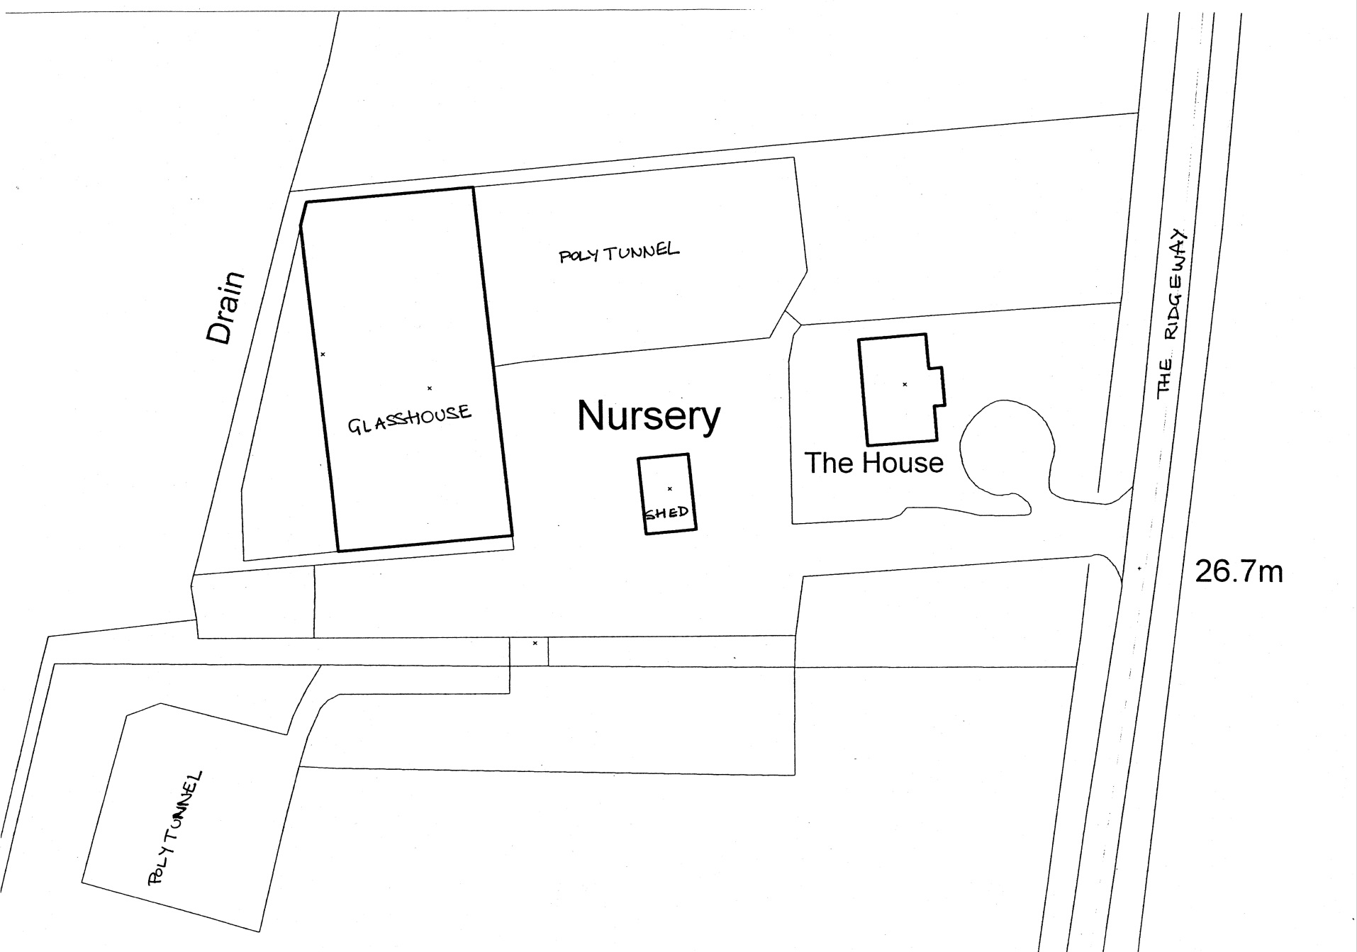
Existing Layout

Slide 14
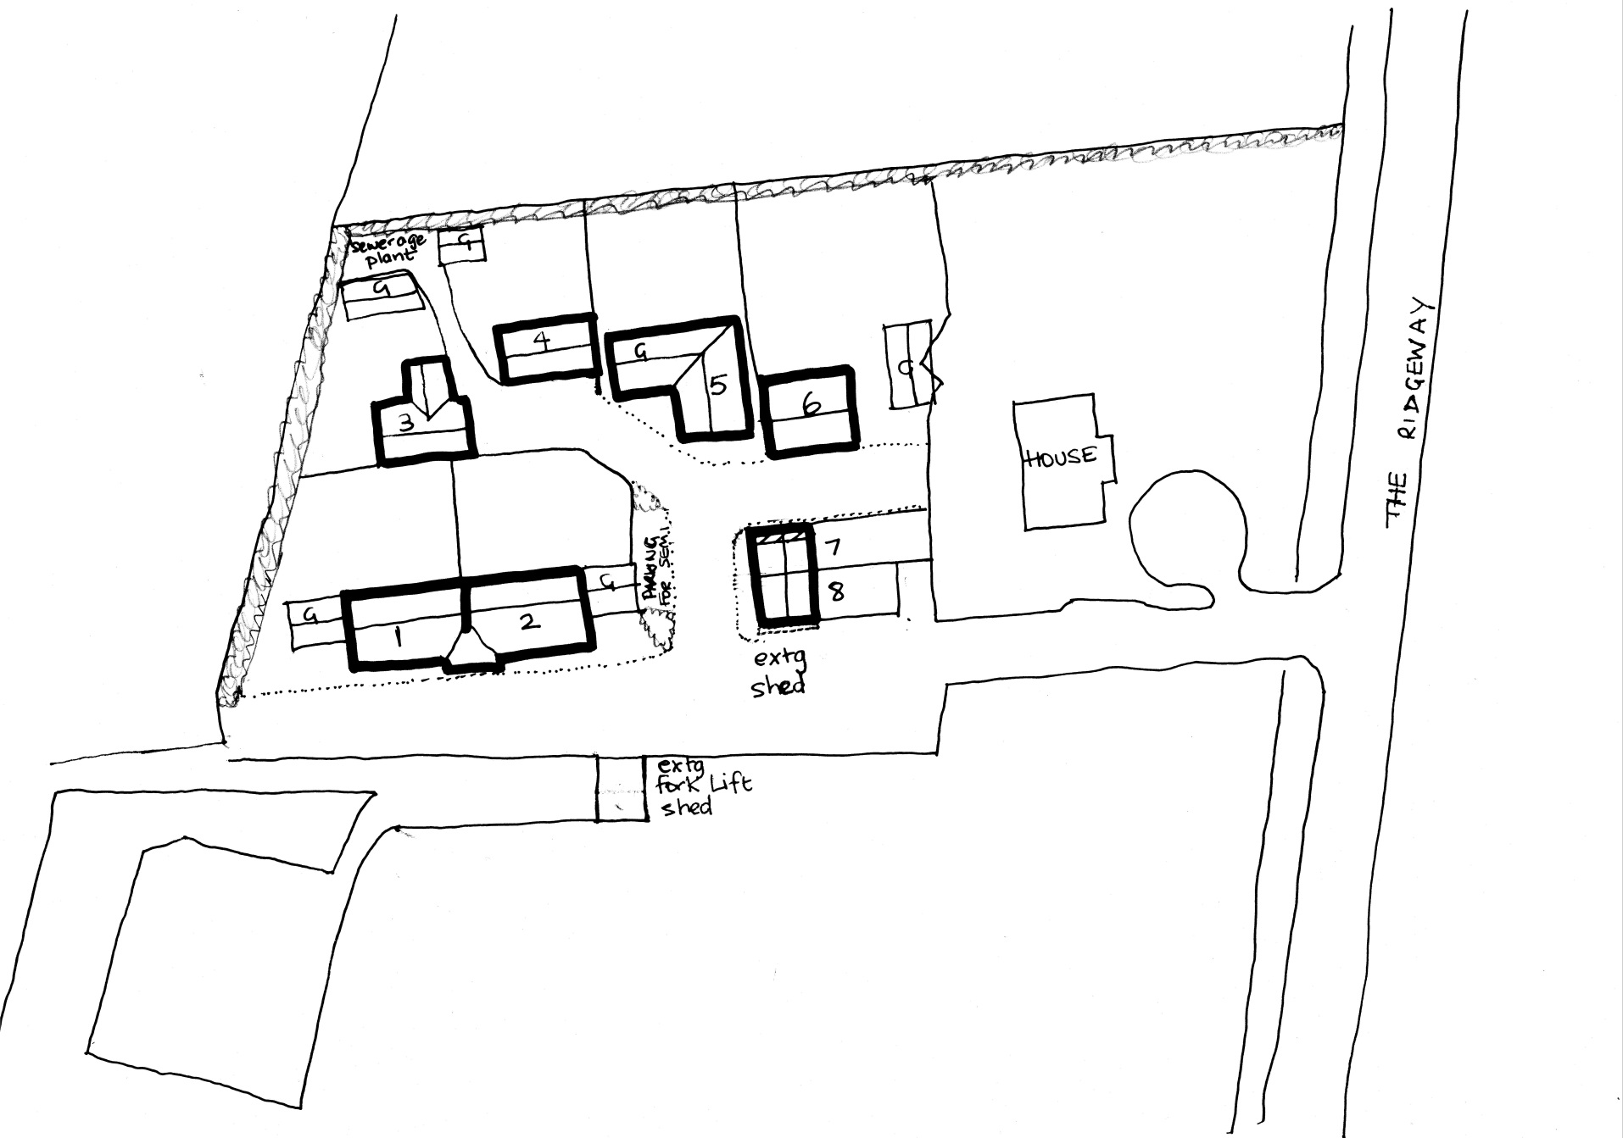
Proposed Layout

Slide 15
Is the development too isolated?
The nursery site is closer to the village via the proposed footpath than the outlaying parts of Chalton .i.e. 38A & The Barns , Chalton Terrace and the Pink Cottage.
The nursery site is also about the same distance from the school as the corner of Park Road adjacent to the entrance to Moggerhanger House.
Our children regularly walk into Moggerhanger and home and the footpath would be a 'safe walk ' without motorised traffic. In view of the obesity epidemic, surely a 15 minute daily walk should be encouraged.
Many villages have a central nuclei with outlying houses.
Notes:
Our children regularly walk into Moggerhanger and home and the footpath would be a 'safe walk ' without motorised traffic. In view of the obesity epidemic, surely a 15 minute daily walk should be encouraged.

Slide 16
Are there too many houses?
Central Bedfordshire has a shortfall in the number of houses being built.
The site is not dissimilar in size to the site owned by Charles Well adjacent to the Guinea pub: that site is to be redeveloped with 18 houses in total.

Slide 17
What now?
Please indicate whether you are willing to support our scheme by indicating on the attendance sheet.
Further action will be required by writing to support scheme when planning permission is sought.
Lobbying your local representative (parish council and Tricia Turner)

Slide 18
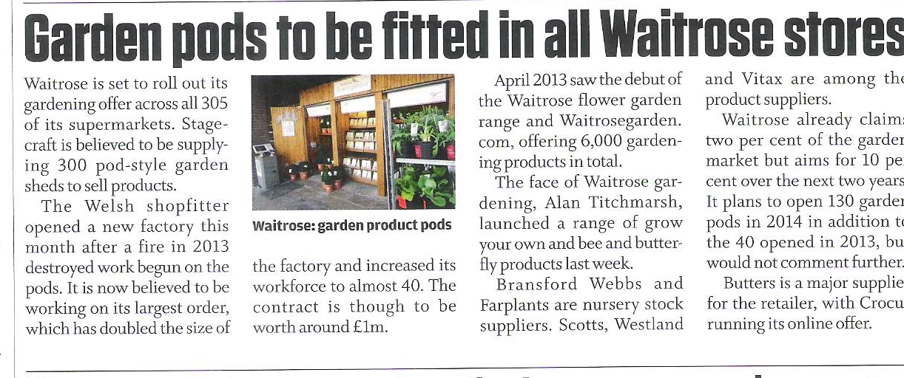
Articles & Research on Viability
From Horticulture Week 21st March to3rd April 2014

Slide 19
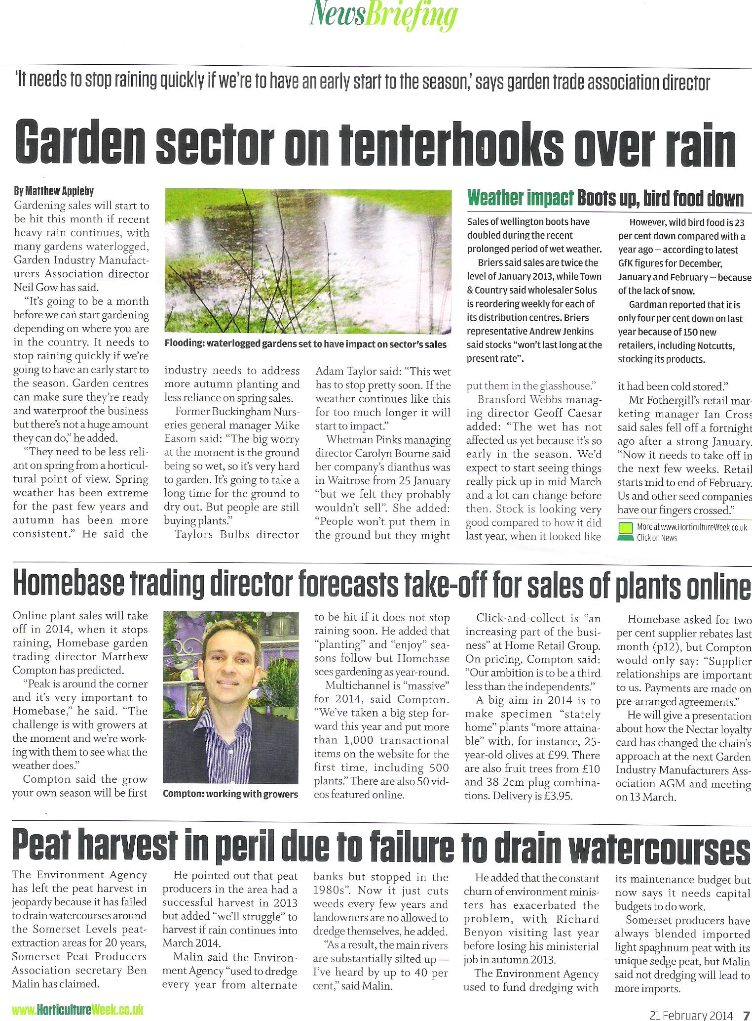
From Horticulture Week 21st February to 6th March 2014

Slide 20
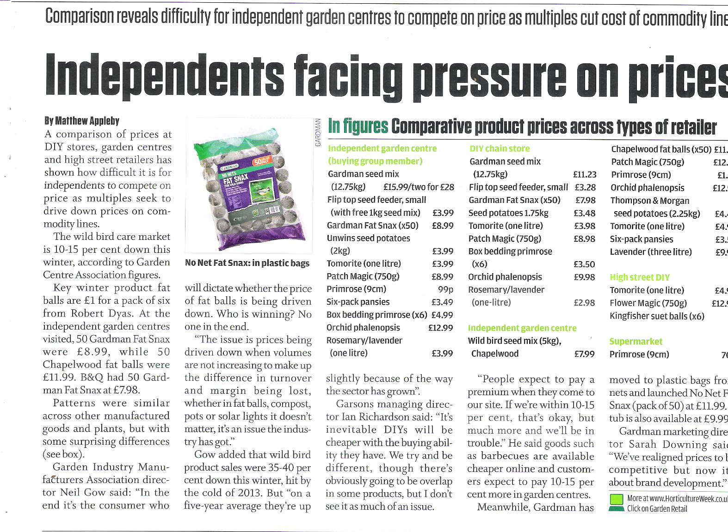
From Horticulture Week 21st February to 6th March 2014

Slide 21
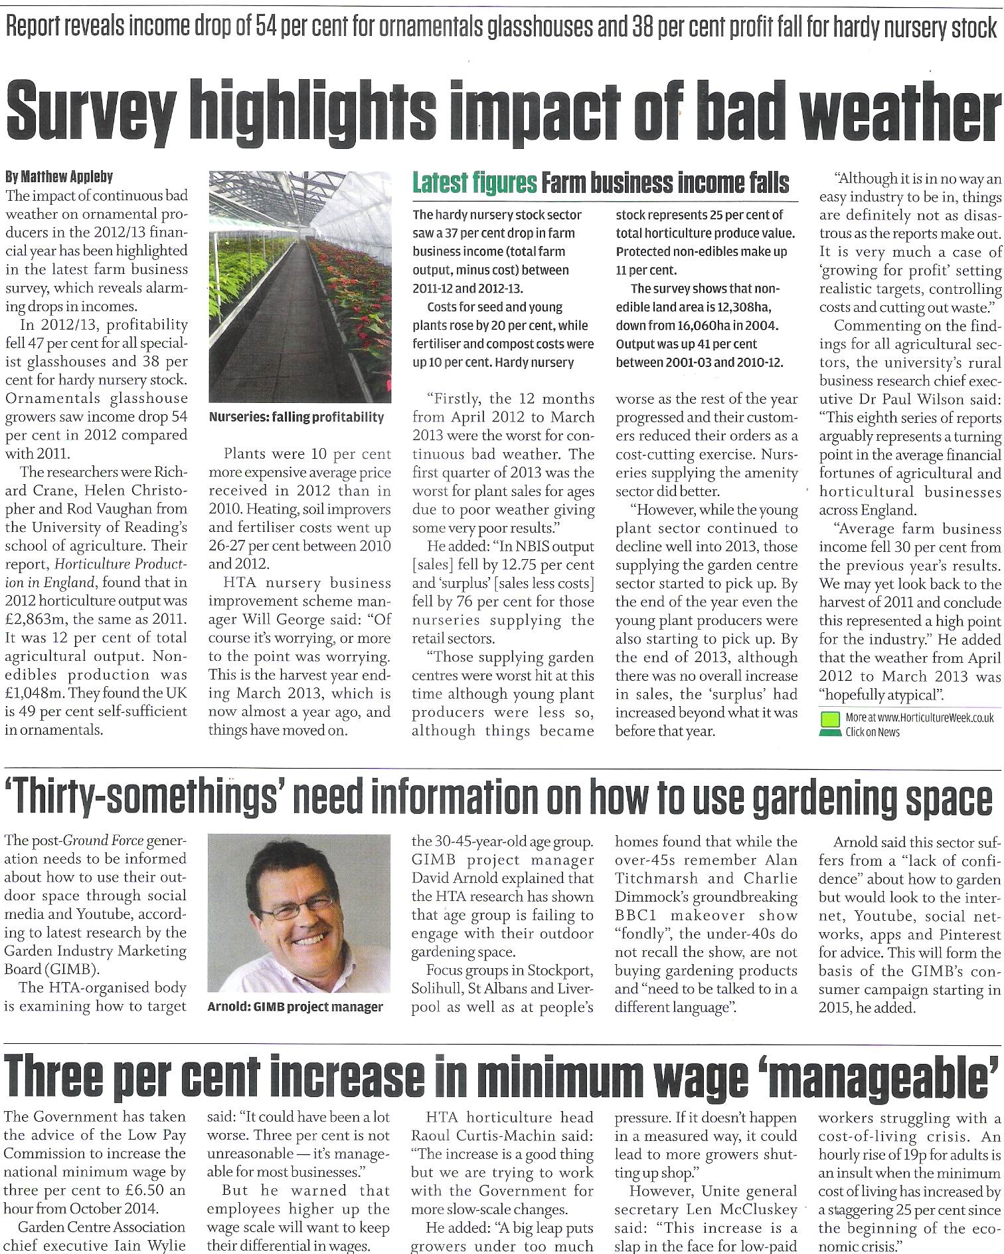
From Horticulture Week 21st March to3rd April 2014

