Slide 1
AGM
April 13, 2013

Slide 2
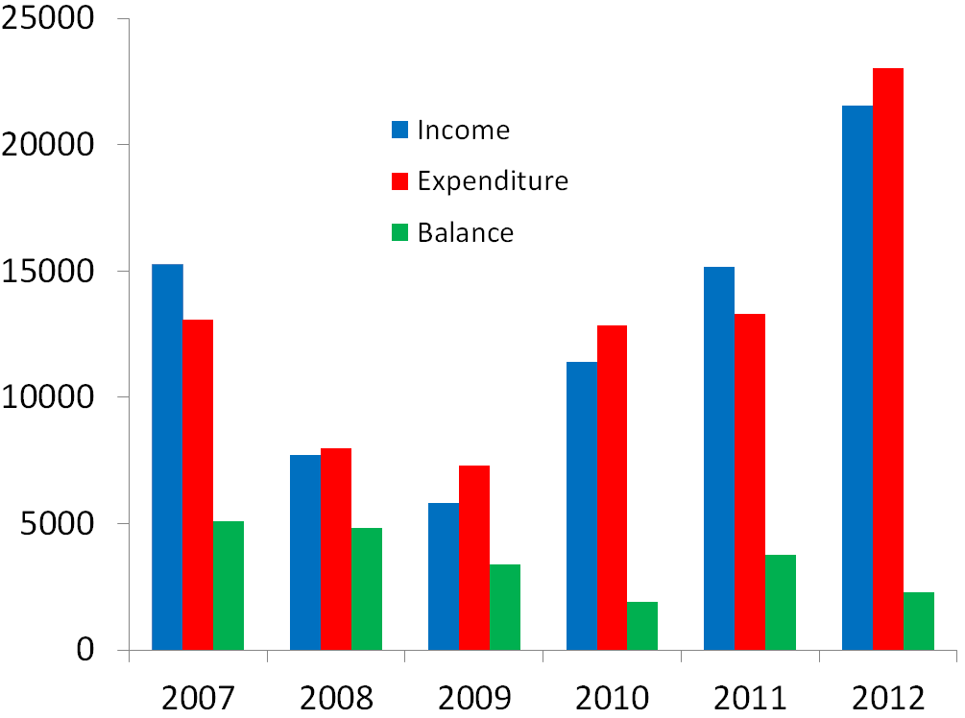
Accounts Summary 2007-2012

Slide 3
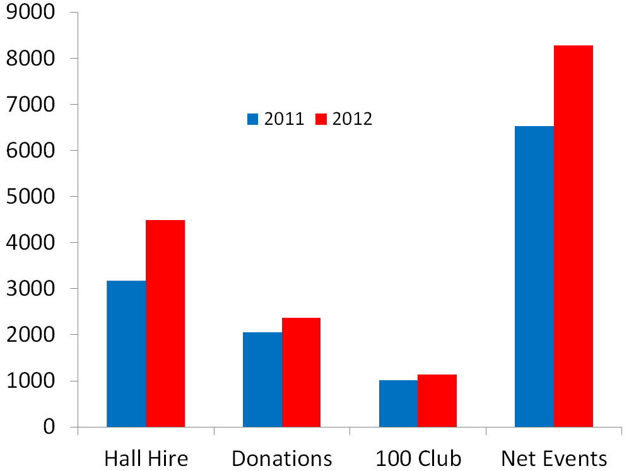
Income 2012 cf 2011

Slide 4
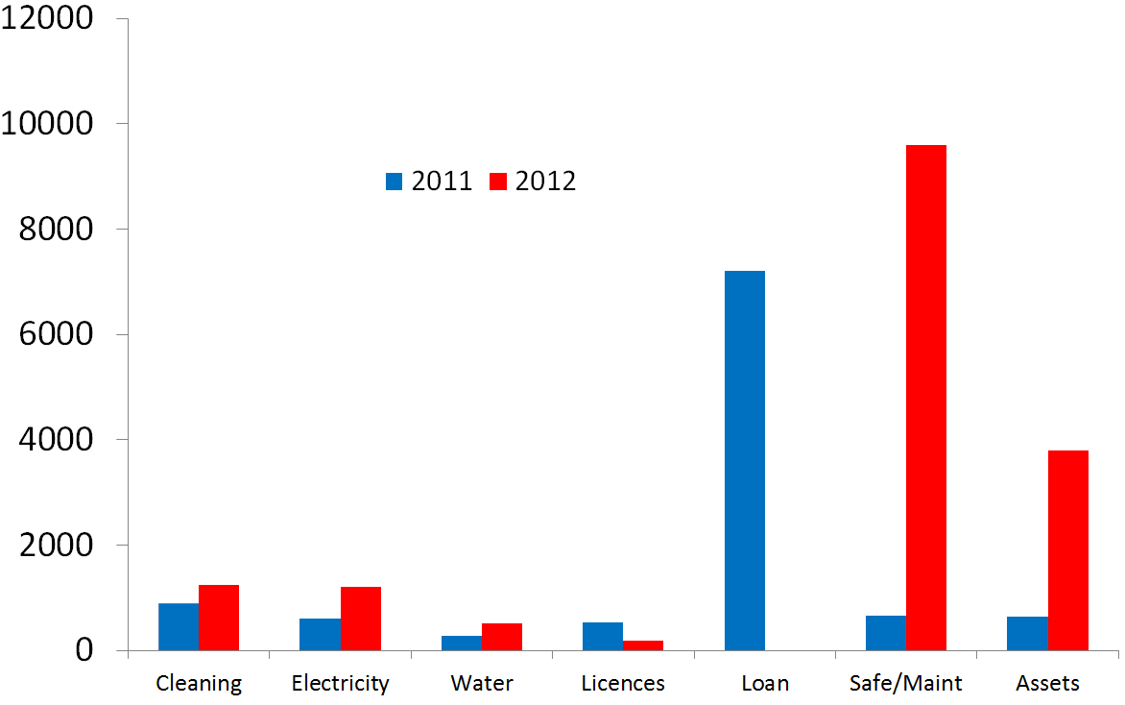
Expenditure 2012 cf 2011

Slide 5
Key Points (1)
Electricity Savings
  Changed Supplier to Scottish Power
  Slight increase due to 24/7 running during winter months
Loans
  Cleared £7213.41 in 2011
  Cleared £4150 in 2012 (Drain work)
Grant Application to WREN
  Granted awarded and project completed (£19,800)
  Trustees spend over £4000 on the project
  Many thanks to Parish Council as third party contributor (11%)

Slide 6
Key Points (2)
Event Profits up £1750 on previous year
Private Party Bars Profitable £1648
Hall letting up £1300 on previous year
Maintenance & Refurbishment £9594
Assets £3800
Giving Machine over £300 to date

Slide 7
Key Points (3)
Events
  Varied events but also continued to reduce costs
  Bingo – monthly
  Casino Night
  Quiz Night
  Split Whiskers
  Social events for 100 club members
  New Years Eve Party
  Private Events – e.g. Pancakes, Disney Party
  More people through the door

Slide 8
OUTLOOK - As Last Year - Cautious Optimism
~
Thanks to Mr E Fuller (Auditor)
~
Thank you
~
Before the Formal Adoption of accounts are there any questions

